Slide 1


COVAX MANAGEMENT
Group -03
Ayushi Sharma – h20201030157h
Himanshu Gupta- h20201030121h

Slide 2
Covax Management
We have made this website with the help of the Django framework, used Python language and Mysql Database to store the data.
Django can be used to built any type of websites. It can work with Client-side framework and can deliver content in almost any format.
Django web applications typically group the code that handles each of these steps into separate files:
URLs: While it is possible to process requests from every single URL via a single function, it is much more maintainable to write a separate view function to handle each resource. A URL mapper is used to redirect HTTP requests to the appropriate view based on the request URL. The URL mapper can also match particular patterns of strings or digits that appear in a URL and pass these to a view function as data.
View: A view is a request handler function, which receives HTTP requests and returns HTTP responses. Views access the data needed to satisfy requests via models, and delegate the formatting of the response to templates.
Models: Models are Python objects that define the structure of an application's data, and provide mechanisms to manage (add, modify, delete) and query records in the database.
Templates: A template is a text file defining the structure or layout of a file (such as an HTML page), with placeholders used to represent actual content. A view can dynamically create an HTML page using an HTML template, populating it with data from a model. A template can be used to define the structure of any type of file; it doesn't have to be HTML!

Slide 3
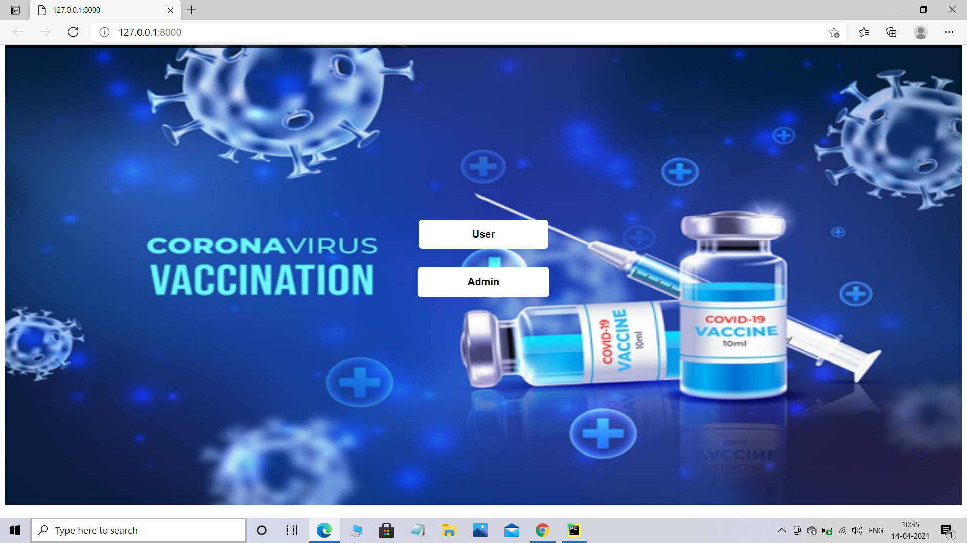
COVAX MANAGEMENT
Our website can be operated in two modes:
USER MODE
ADMIN MODE

Slide 4
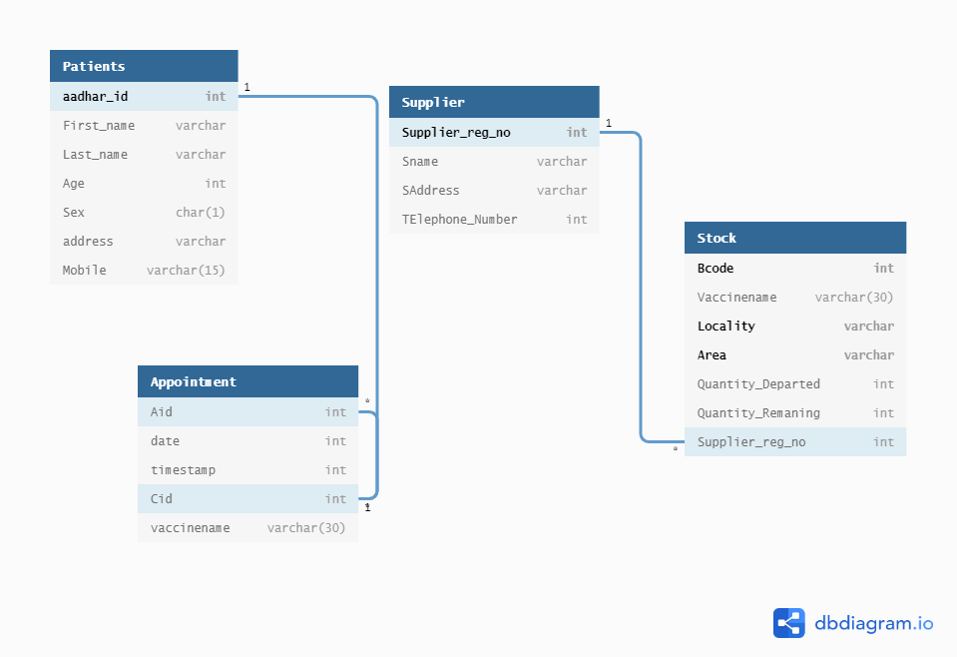
UML Diagram

Slide 5

USER MODE
There are two operations user can perform:
Registration
Make an appointment

Slide 6
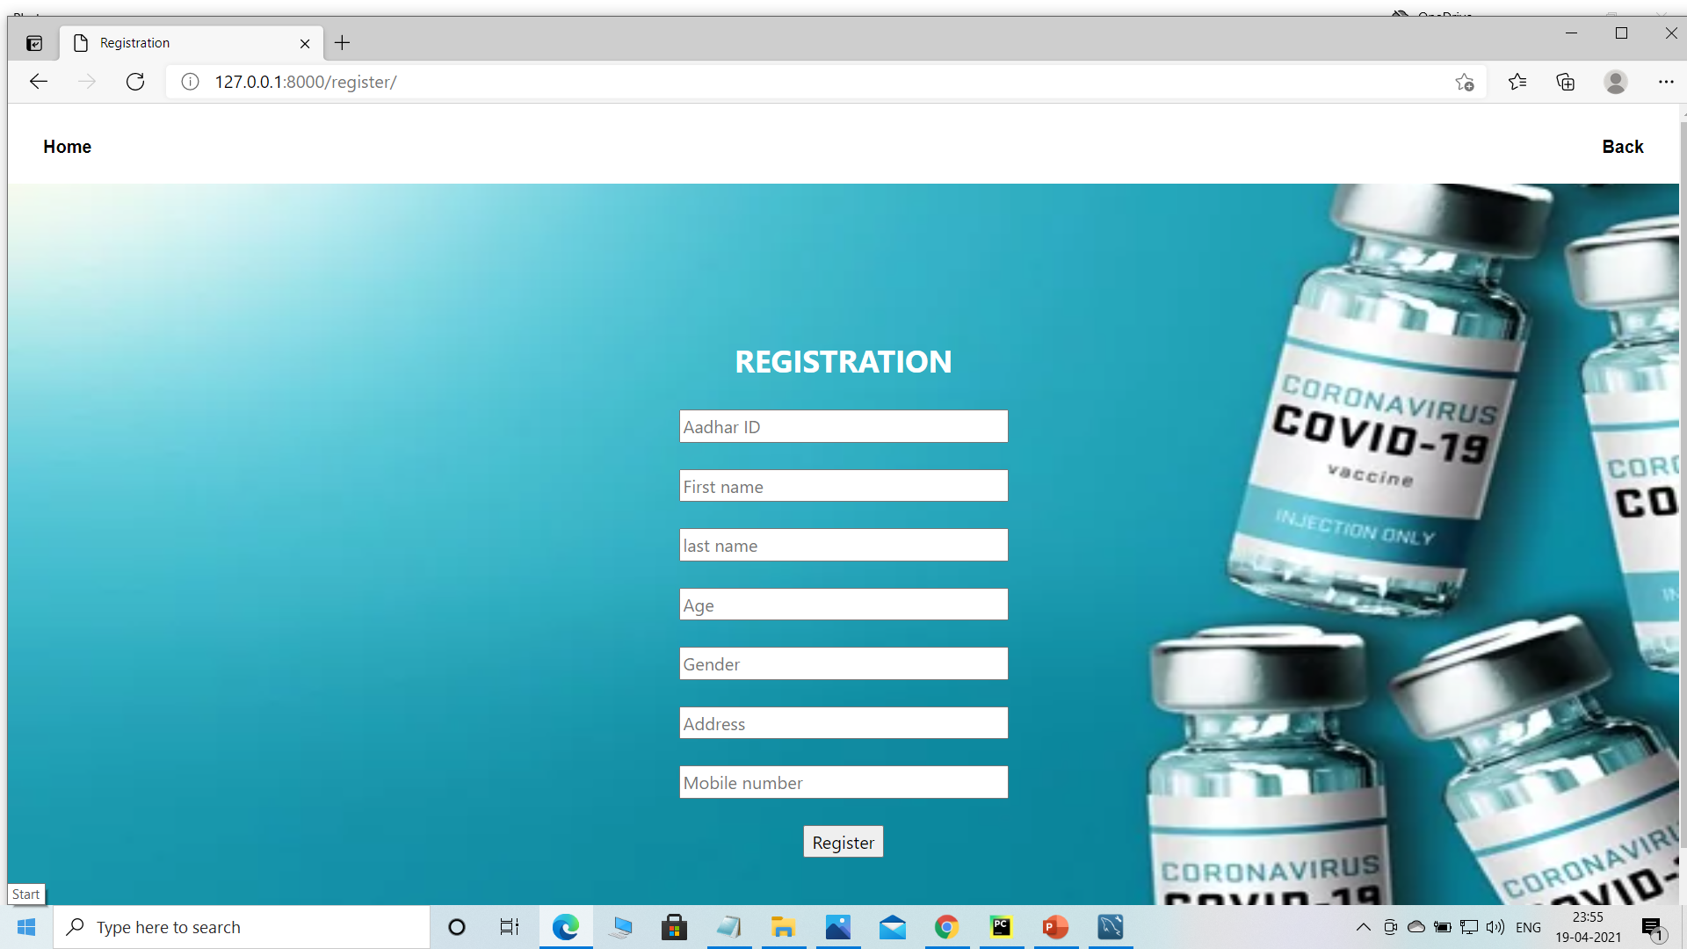
User Mode(Register)
User who want to register can register by filling the form correctly. If user made any mistake while filling the form he will get the popup message.
Without registration User will not be able to make an appointment for the vaccination.

Slide 7
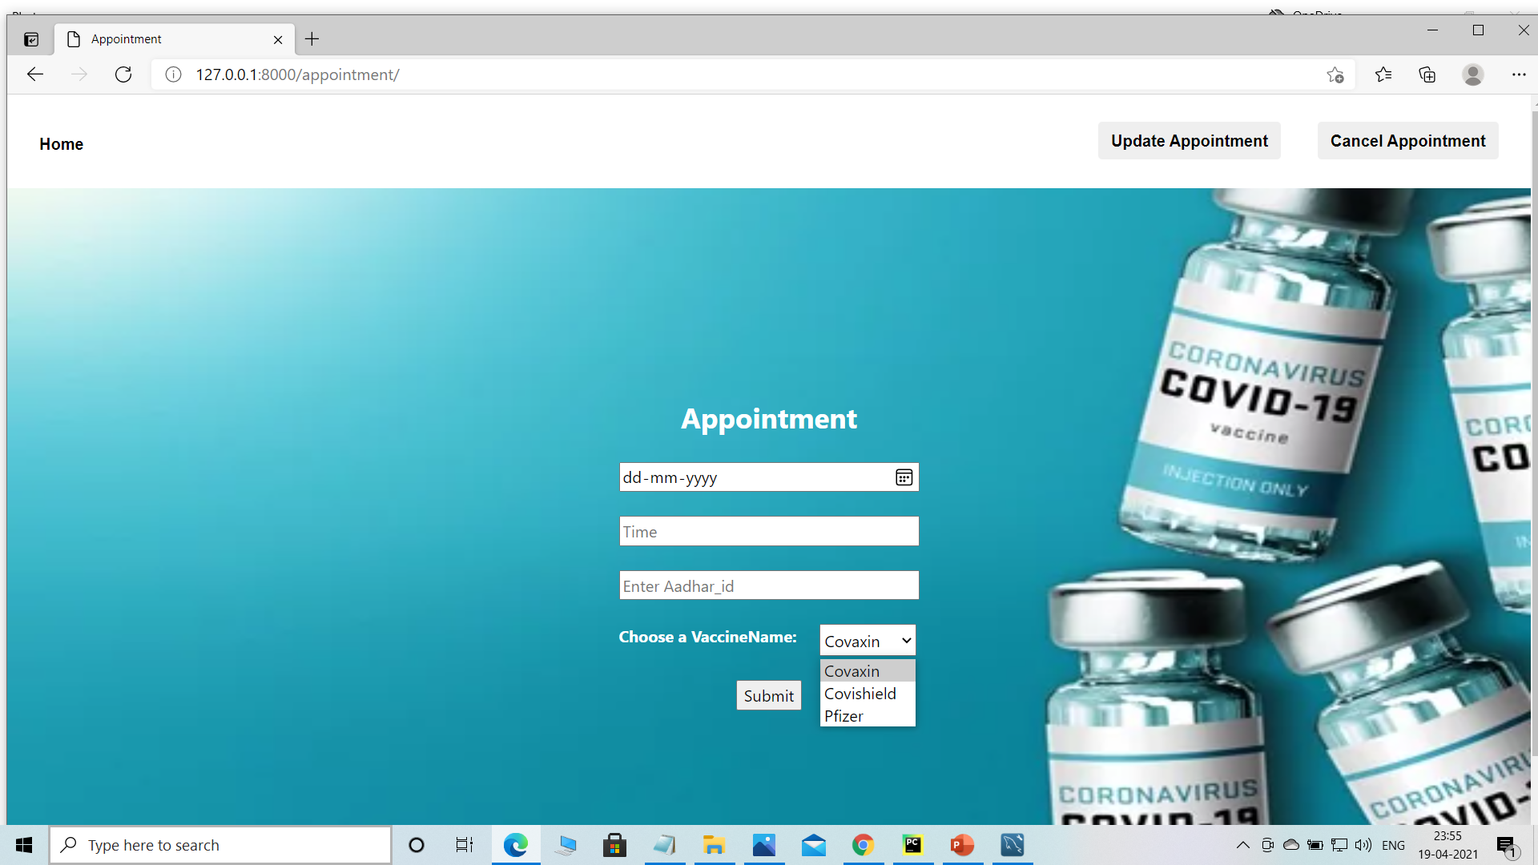
User Mode(Appointment)
If user want to book an appointment then he will book an appointment by filling the details in the form as attached here.
To book an appointment user need to registered first if not registered.
If user is trying to make an appointment without registering then he will get a popup message.
If user wants to update his appointment or delete his appointment then user can do this as well.

Slide 8
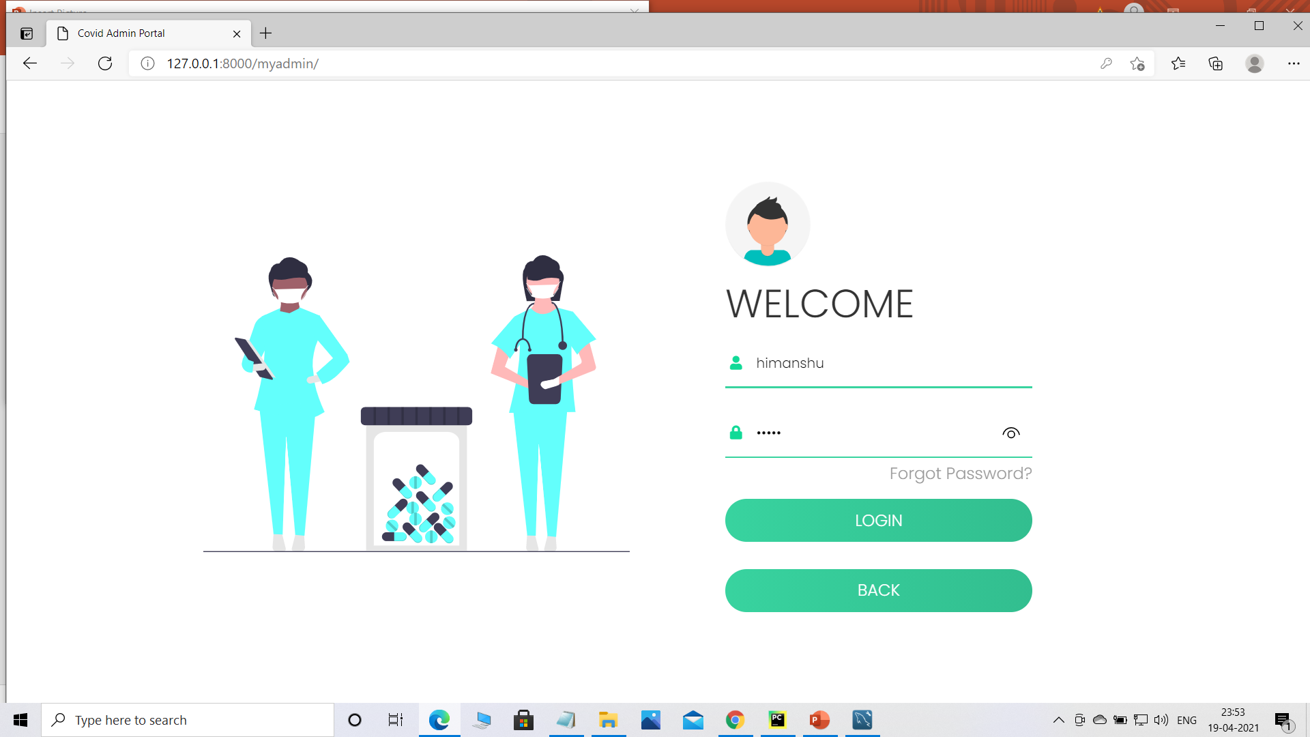
ADMIN MODE(Login Page)
Admin need to fill the credentials in the login form to view admin side data. If admin forgot the password He/She can click on the forgot password and get to know the password through the email entered in the form opened after clicking on the forgot password link.

Slide 9
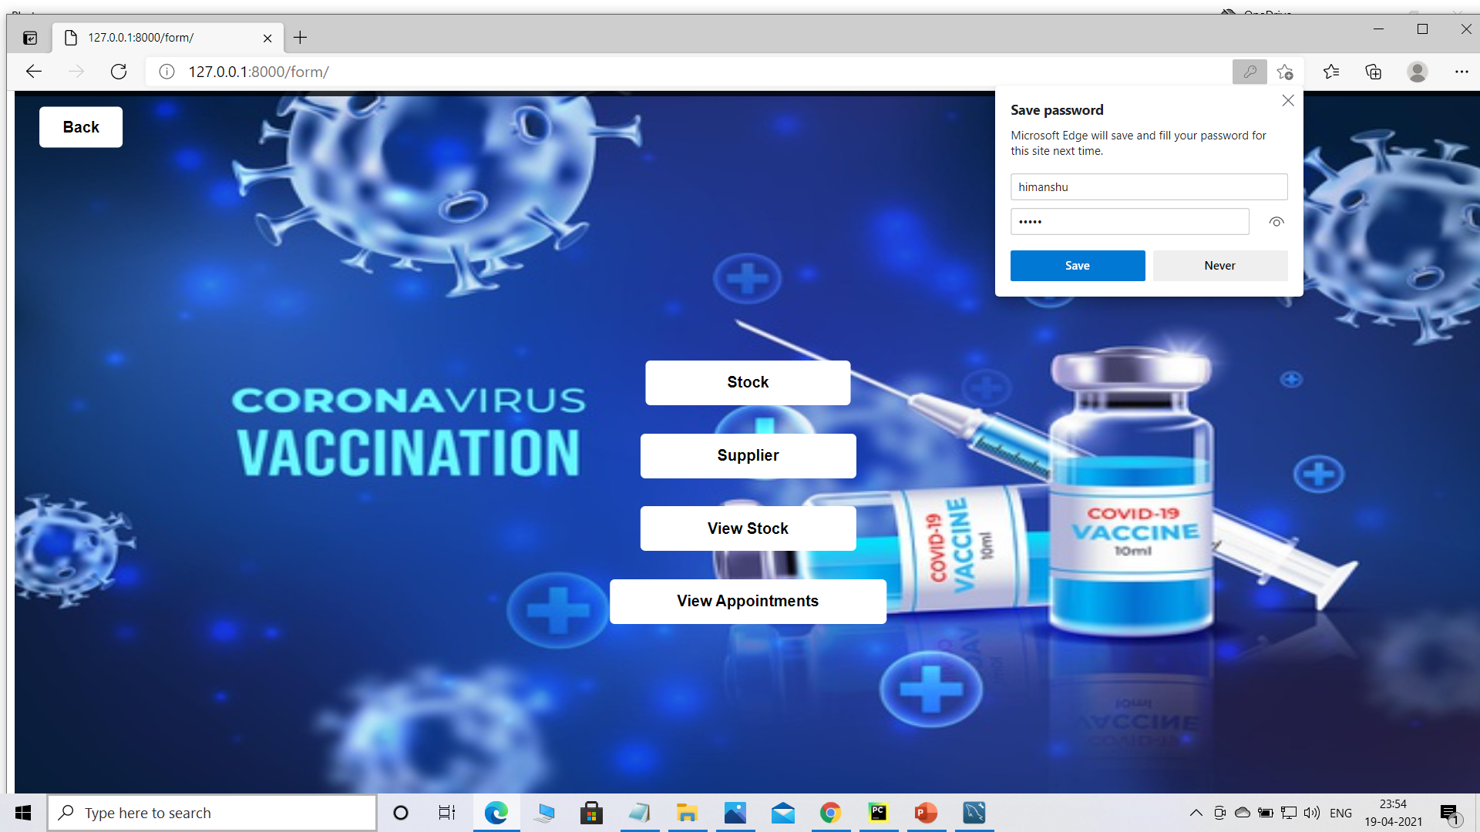
ADMIN SIDE DATA
There are some features available at admin’s side.
Supplier: As you are an admin you should know from which supplier you are receiving the vaccines and maintain the Supplier table by filling the details of the Supplier.
Stock: Similarly Admin has a knowledge of the stock of vaccines and admin need to maintain the stock table.
View Appointments: With the help of these feature Admin can see the details of the people’s who took an an appointment, if user can cancel or update its appointment it will also get reflected in table as well.

Slide 10
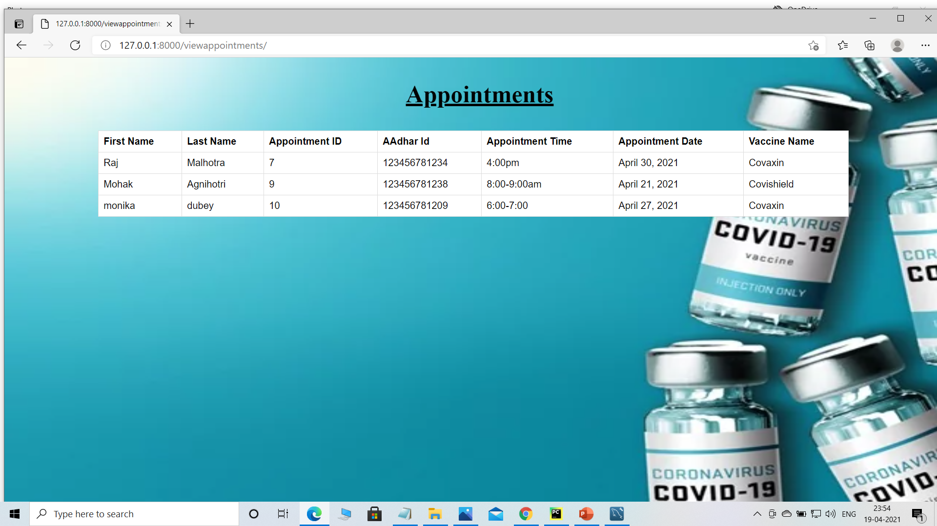
View Appointment Table

Slide 11
Video Link: https://drive.google.com/drive/folders/1zhlHIX62h9LEjxleSLSk_EZ0bWEvR7m9?usp=sharing

Slide 12
Thank You

